Slide 1
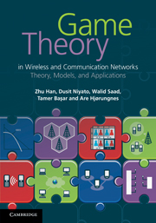
Game Theory in Wireless and Communication Networks: Theory, Models, and Applications
Lecture 4
Evolutional Game
Zhu Han, Dusit Niyato, Walid Saad,
Tamer Basar, and Are Hjorungnes

Slide 2
Overview of the Lecture Notes
Introduction to Game Theory: Lecture 1, book 1
Non-cooperative Games: Lecture 1, Chapter 3, book 1
Bayesian Games: Lecture 2, Chapter 4, book 1
Differential Games: Lecture 3, Chapter 5, book 1
Evolutionary Games: Lecture 4, Chapter 6, book 1
Cooperative Games: Lecture 5, Chapter 7, book 1
Auction Theory: Lecture 6, Chapter 8, book 1
Matching Game: Lecture 7, book 2
Contract Theory, Lecture 8, book 2
Stochastic Game, Lecture 9, book 2
Learning in Game, Lecture 10, book 2
Equilibrium Programming with Equilibrium Constraint, Lecture 11, book 2
Mean Field Game, Lecture 12, book 2
Zero Determinant Strategy, Lecture 13, book 2
Network Economy, Lecture 14, book 2
Game in Machine Learning, Lecture 15, book 2
[<number>]

Slide 3
Overview
Basics of evolutionary
  Equilibrium selection, bounded rationality, and dynamic behavior of players
Two approaches in the evolutionary game framework
  Static: evolutionary stable strategies (ESS)
  Dynamic: replicator dynamics with evolutionary equilibrium
Some of these applications have been discussed
  Congestion control
  Power control in CDMA,
  Cooperative sensing in cognitive radio
  Service provider selection (i.e., churning)
[<number>]

Slide 4


Overview of Evolutional Game
Evolutionary game theory has been developed as a mathematical framework to study the interaction among rational biological agents in a population
Agent adapts (i.e., evolves) the chosen strategy based on its fitness (i.e., payoff)
Example, hawk (be aggressive) and dove (be mild)
[<number>]

Slide 5
Overview of Evolutional Game
Evolutionary game theory has the following advantages over the traditional noncooperative game theory
  The solution of the evolutionary game (i.e., evolutionary stable strategies (ESS) or evolutionary equilibrium) can serve as a refinement to the Nash equilibrium (e.g., Nash equilibrium is not necessarily efficient, there could be multiple Nash equilibria in a game, or the Nash equilibrium may not exist)
  The strong rationality assumption is not required in evolutionary game as evolutionary game theory has been developed to model the behavior of biological agents
  Evolutionary game is based on an evolutionary process, which is dynamic in nature which can model and capture the adaptation of agents to change their strategies and reach equilibrium over time
[<number>]

Slide 6
Evolution Process
In an evolutionary game, the game is played repeatedly by agents who are selected from a large population
Two major mechanisms of the evolutionary process and the evolutionary game are mutation and selection
  Mutation is a mechanism of modifying the characteristics of an agent (e.g., genes of the individual or strategy of player), and agents with new characteristics are introduced into the population
  The selection mechanism is then applied to retain the agents with high fitness while eliminating agents with low fitness
In evolutionary game, mutation is described by the evolutionary stable strategies (ESS) from static system perspective
Selection mechanism is described by the replicator dynamics from dynamic system perspective
[<number>]

Slide 7
Evolutionary Stable Strategies (ESS)
ESS is the key concept in the evolutionary process in which a group of agents choosing one strategy will not be replaced by other agents choosing a different strategy when the mutation mechanism is applied
Initial group of agents in a population chooses incumbent strategy s
Small group of agents whose population share is ε choosing a different mutant strategy s’
Strategy s is called evolutionary stable if
where u(s, s’) denote the payoff of strategy s given that the opponent chooses strategy s’
[<number>]

Slide 8

Example: Hawk-Dove Game
There are two types of agents competing for a resource (i.e., food) of fixed value V
Each agent chooses strategy from a set of two possibilities (i.e., hawk and dove)
  Hawk is aggressive and will not stop fighting until it is injured or until the opponent retreats
  Dove is mild behavior and always retreat instantly if the opponent initiates aggressive behavior
Resource
[<number>]

Slide 9
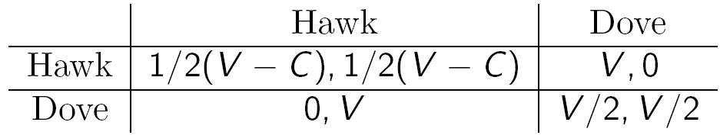
Example: Hawk-Dove Game
There are 4 cases
  1) Both agents adopt hawk behavior (i.e., aggressive), the competition will result in both being equally injured with cost C
  2) One adopts hawk another adopts dove; dove immediately retreats and earns zero payoff, while the hawk captures the resource V
  3) When both adopt dove behavior, they will share the resource equally (V/2)
Payoff matrix
Almost all agents in the population adopt evolutionary stable strategy, no mutant (i.e., a small number of agents adopting a different strategy) can invade
[<number>]

Slide 10
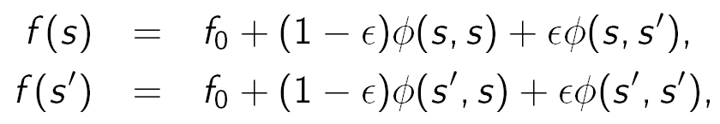
Example: Hawk-Dove Game
Illustration
  Let φ(s₁, s₂) denote the change in fitness for an agent adopting strategy s₁ against opponent adopting strategy s₂, and let f(s) denote the total fitness of an agent adopting strategy s
  Let f₀ denote the initial fitness, s denote the ESS, and s’ denote the mutant strategy
  The fitness of the agents adopting the different strategies can be express as follows:
  Where ε is proportion of the population for the mutant strategy s’
[<number>]

Slide 11
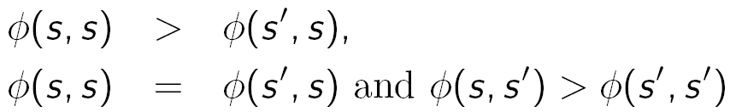
Example: Hawk-Dove Game
Illustration (Cont.)
  For ESS, the fitness of the agent adopting strategy s must be larger than that of those members of the population choosing strategy s’ (i.e., f(s) > f(s’))
  If ε approaches zero, it is required that either of these conditions holds, i.e.,
For Hawk-Dove game, the dove is not ESS since a pure population of doves can be invaded by a hawk mutant
If resource V is larger than the cost of both agents behaving aggressively (i.e., V > C), then the hawk is ESS as there is value in both agents competing for a resource even though they would be hurt
Otherwise, there is no ESS in this game
[<number>]

Slide 12

Replicator Dynamics
Population can be divided into multiple groups, and each group adopts a different pure strategy
Replicator dynamics can model the evolution of the group size over time (unlike ESS, in replicator dynamics agents will play only pure strategies)
The proportion or fraction of agents using pure strategy s (i.e., population share) is denoted by x_{s}(t) whose vector is x(t)
Let payoff of an agent using strategy s given the population state x be denoted by u(s, x)
Average payoff of the population, which is the payoff of an agent selected randomly from a population, is given by
[<number>]

Slide 13


Replicator Dynamics
The reproduction rate of each agent (i.e., the rate at which the agent switches from one strategy to another) depends on the payoff (agents will switch to strategy that leads to higher payoff)
Group size of agents ensuring higher payoff will grow over time because the agents having low payoff will switch their strategies
Dynamics (time derivative) of the population share can be expressed as follows:
Evolutionary equilibrium can be determined at
where actions of the population choosing different strategies cease to change
[<number>]

Slide 14
Replicator Dynamics
It is important to analyze the stability of the replicator dynamics to determine the evolutionary equilibrium
Evolutionary equilibrium can be stable (i.e., equilibrium is robust to the local perturbation) in the following two cases:
  1) Given the initial point of replicator dynamics sufficiently close to the evolutionary equilibrium, the solution path of replicator dynamics will remain arbitrarily close to the equilibrium (Lyapunov stability)
  2) Given the initial point of replicator dynamics close to the evolutionary equilibrium, the solution path of replicator dynamics converges to the equilibrium (asymptotic stability)
Two main approaches to prove the stability of evolutionary equilibrium are based on the Lyapunov function and the eigenvalue of the corresponding matrix
[<number>]

Slide 15
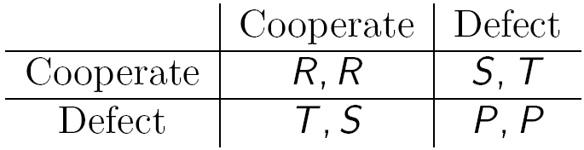

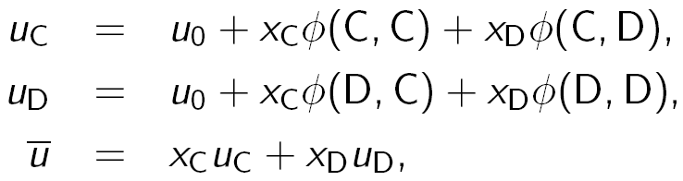
Example: Prisoner's Dilemma
Two agents choose a strategy of cooperate or defect
where T > R > P > S
x_{C} and x_{D} denote the proportions of the population adopting cooperate and defect strategies, respectively
Average fitness of agents adopting these two strategies are denoted by u_{C} and u_{D}, respectively
Average fitness of the entire population is obtained from
Change in fitness
[<number>]

Slide 16

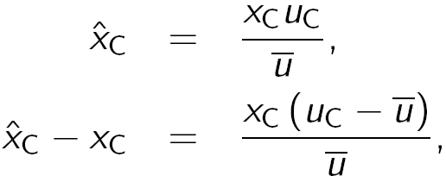
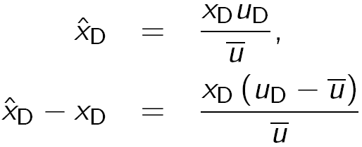
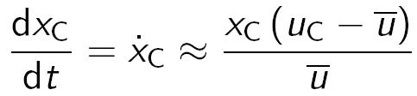
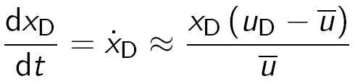
Example: Prisoner's Dilemma
The future proportion of the population adopting the strategies depends on the current proportion
Consider small time interval, the differential equations (replicator dynamics) are
Cooperate
Defect
[<number>]

Slide 17

Example: Prisoner's Dilemma
For the prisoner's dilemma case, we have u_{C} = u₀ + x_{C}R + x_{D}S and u_{D} = u₀ + x_{C}T + x_{D}P
Since T > R and P > S, it is clear that u_{D} > u_{C}, and
Therefore, as time increases, the proportion of the population adopting the cooperate strategy will approach zero (i.e., becomes extinct)
From replicator dynamics, defect strategy constitutes the evolutionary equilibrium
Also, it can be proven that defect strategy is the ESS of the prisoner's dilemma game
[<number>]

Slide 18
Overview
Basics of evolutionary
  Equilibrium selection, bounded rationality, and dynamic behavior of players
Two approaches in the evolutionary game framework
  Static: evolutionary stable strategies (ESS)
  Dynamic: replicator dynamics with evolutionary equilibrium
Some of these applications have been discussed
  Congestion control
  Power control in CDMA,
  Cooperative sensing in cognitive radio
  Service provider selection (i.e., churning)
[<number>]

Slide 19
Applications of Evolutionary Game
Congestion control
The competition among two types of behaviors (i.e., aggressive and peaceful) in wireless nodes to access the channel using a certain protocol can be modeled as an evolutionary game
Congestion control is (transport layer) to avoid performance degradation by the ongoing users by limiting transmission rate
The transmission rate (i.e., of TCP) can be adjusted by changing the congestion window size (i.e., the maximum number of packets to be transmitted)
The speed-of-transmission rate to be increased and decreased defines the aggressiveness of the protocol
[<number>]

Slide 20
Applications of Evolutionary Game
Congestion control
TCP protocol with the additive increase multiplicative decrease (AIMD) mechanism can control this aggressiveness through the parameters determining the increase and decrease
If the transmitted packet is successful, the window size will linearly increase by α packets for every round trip time
Otherwise, the window size will decrease by β proportional to the current size
[<number>]

Slide 21

Applications of Evolutionary Game
Congestion control
Multiple flows share the same link, competitive situation arises
It is found that the aggressive strategy of all flows (i.e., large values of α and β) becomes the Nash equilibrium, and the performance will degrade significantly due to the congestion
Shared link
Senders
Receivers
[<number>]

Slide 22
Applications of Evolutionary Game
Congestion control – Static game
Analysis of the TCP protocol in a wireless environment is performed in which the evolutionary game model (similar to the Hawk and Dove game)
There are two populations (i.e., groups) of flows with TCP
The flow from population i is characterized by parameters α_{i} and β_{i}, which are the increase and decrease rates, respectively
Strategy s of flow is to be aggressive (i.e., hawk or H) to be peaceful (i.e., dove or D)
The parameters associated with these strategies are given as
[<number>]

Slide 23

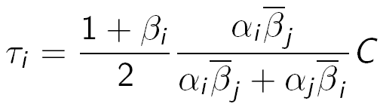

Applications of Evolutionary Game
Congestion control – Static game
The packet loss occurs when the total transmission rate of all flows reaches the capacity C- i.e., x₁r₁ +x₂r₂ = C, where x_{i} is the proportion of population choosing aggressive behavior
The payoff of flow in population i is defined as follows:
where τ_{i} is the average throughput, L is the loss rate, and ω is the weight for the loss
Throughput of flow from population i can be obtained from
[<number>]

Slide 24
Applications of Evolutionary Game
Congestion control – Static game
The average throughput and loss rate can be defined as functions of strategies of two populations i.e., τ_{i}(s_{i}, s_{j}) and L(s_{i}, s_{j})
It is shown that τ_{i}(H, H) = τ_{i}(D, D)
When the loss rate is considered, it increases as the flow becomes more aggressive, i.e., larger values of α_{i} and β_{i}
Therefore, it can be shown that u_{i}(H, H) < u_{i}(D, D) and u_{i}(D, H) < u_{i}(D, D)
Game becomes a Hawk and Dove model whose solution is ESS
Briefly, it is found that the application that is loss-sensitive will tend to use a less aggressive strategy at ESS
[<number>]

Slide 25
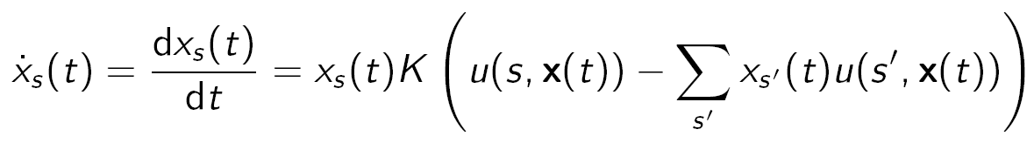
Applications of Evolutionary Game
Congestion control – Dynamic game
Dynamics of strategy selection by the flows in two populations can also be analyzed using the replicator dynamics
x_{s} is the proportion of the population choosing strategy s and x_{s}(t) is a vector of x_{s} at time t; u(s, x(t)) is the payoff of using strategy s, and K is a speed constant (positive)
[<number>]

Slide 26


Applications of Evolutionary Game
Evolutionary Game for WCDMA Access
Evolutionary game is formulated for the WCDMA system
The number of interfering nodes is random, which depends on the geographical location of the mobile nodes
Mobile nodes have two strategies to use high and low power levels, which correspond to the transmit power P_{H} and P_{L}, respectively
P_{L}
P_{H}
P_{H}
[<number>]

Slide 27
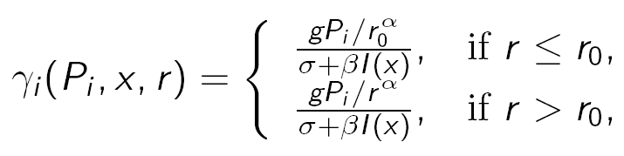
Applications of Evolutionary Game
Evolutionary Game for WCDMA Access
Signal-to-interference-plus-noise ratio (SINR) with distance r between transmitter and receiver of node i is given by
  P_{i} is the strategy of node i (i.e., P_{H} or P_{L})
  x is the proportion of the population choosing P_{H}
  g is channel gain, r₀ is the radius-of-reception circle of receiver
  α is the attenuation order with value between 3 and 6, σ is the noise power, and β is the inverse of processing gain
  I(x) is total interference from all nodes to the receiver of node i
[<number>]

Slide 28
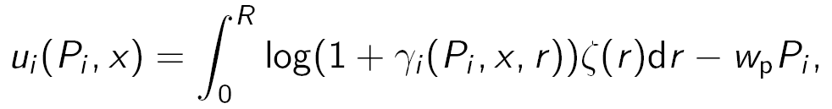
Applications of Evolutionary Game
Evolutionary Game for WCDMA Access
Payoff of node i is as follows:
  R is the transmission range, and w_{p} is the cost weight due to adopting transmit power P_{i} (e.g., energy consumption)
  ζ(r) is the probability density function given the density of receiver
[<number>]

Slide 29
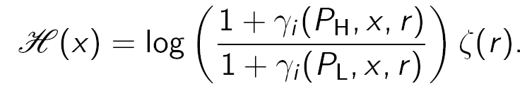
Applications of Evolutionary Game
Evolutionary Game for WCDMA Access
Based on this evolutionary game formulation, the sufficient condition for existence and uniqueness of the ESS in WCDMA access is established
Dynamics of the evolutionary game formulation of WCDMA access can be established based on replicator dynamics
This function is continuous and strictly monotonic, which is required for the proof of stability based on sufficient condition
[<number>]

Slide 30
Applications of Evolutionary Game
Cooperative Sensing in Cognitive Radio
In a cognitive radio network, unlicensed users (i.e., secondary users) performs spectrum sensing to detect licensed users (i.e., primary users) before opportunistically access the spectrum
It is based on sampling the signal with hypotheses that a primary user is present or absent denoted by H₁ and H₀, respectively
Multiple secondary users can cooperate and share the sensing results to reduce the sensing time while maintaining the detection and false-alarm probabilities at the target levels
However, there will be the secondary users who contribute or deny to contribute in cooperative spectrum sensing because they are rational
[<number>]

Slide 31
Applications of Evolutionary Game
Cooperative Sensing in Cognitive Radio
Secondary users denying to participate in cooperative spectrum sensing will have more time for data transmission
However, if none of the secondary users performs cooperative sensing, the throughput will be low because the detection probability is low and false-alarm probability is high
This conflict situation can be analyzed using the evolutionary game framework
[<number>]

Slide 32
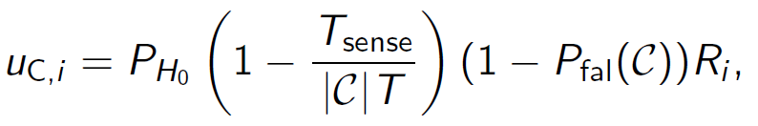
Applications of Evolutionary Game
Cooperative Sensing in Cognitive Radio
The evolutionary game is defined as follows
  Players are the secondary users (i.e., totally N players)
  Strategies are to contribute or deny, which are denoted by C and D, respectively
  The payoff is the throughput of the secondary user defined as follows:
  P_{H0} is the probability of the spectrum to be idle (i.e., a primary user is absent)
  C is a set of contributing secondary users
  P_{fal}(C) is the false-alarm probability given a set of contributing secondary users C, and R_{i} is the transmission rate of user i
[<number>]

Slide 33


Applications of Evolutionary Game
Cooperative Sensing in Cognitive Radio
For denying secondary user j, the payoff function is
  Since the denying secondary users do not need to spend time for sensing, their throughput is large
Replicator dynamics is
x_{i} denote the probability of secondary user i selecting a contributing strategy
[<number>]

Slide 34
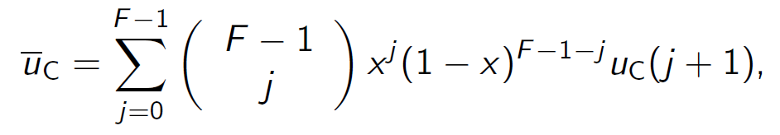
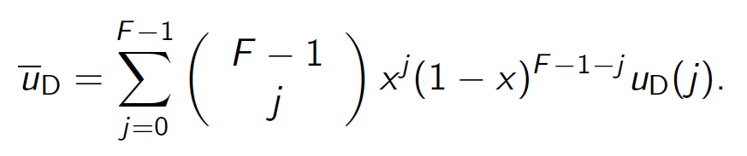
Applications of Evolutionary Game
Cooperative Sensing in Cognitive Radio
For homogeneous case, all secondary users are taken to be identical (i.e., the same detection and false alarm probabilities, and the same transmission rate), average payoffs are
F is the number of channels
Cooperate
Deny
[<number>]

Slide 35

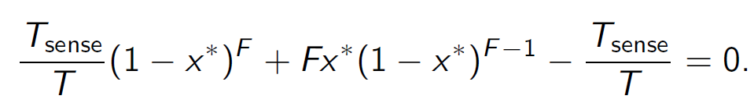
Applications of Evolutionary Game
Cooperative Sensing in Cognitive Radio
Replicator dynamics can be modified to
Also, evolutionary stable strategies (ESS) can be obtained as the solution of x* for by solving the following equation
T_{sense} is the time interval for sensing
T is the length of time slot
[<number>]

Slide 36
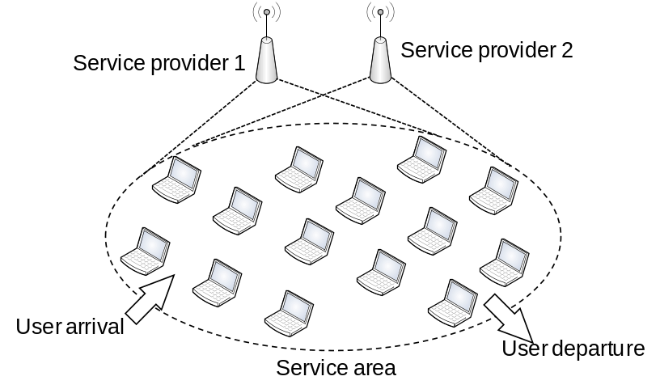
Applications of Evolutionary Game
Mobile User Churning Behavior
Churning of mobile users is common since mobile users have freedom to choose the best wireless service
Churning behavior of wireless service users is analyzed using the theory of evolutionary games
WLAN hotspot is considered where a wireless user can choose among different IEEE 802.11-based WLAN access points based on the performances and/or price
[<number>]

Slide 37
Applications of Evolutionary Game
Mobile User Churning Behavior
Mobile users’ behavior
  User tends to choose and churn to the wireless service provider that returns a higher payoff
  Due to the lack of information about the performance obtained from different service providers and/or inadequate information about the decisions of other users, a user has to gradually learn and change decision on choosing a particular wireless service
  A user can make a wrong decision to choose a wireless service provider that provides a lower payoff randomly with a small probability
  An individual user does not have any intention to influence the decisions of other users in the service area
[<number>]

Slide 38


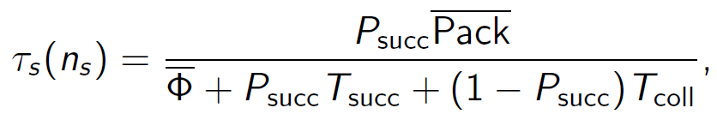
Applications of Evolutionary Game
Mobile User Churning Behavior
The payoff of a user choosing wireless service provider s
is concave utility (logarithmic) function of throughput τ_{s}
p_{s} is a price charged by service provider s to a user
Throughput is obtained from (standard IEEE 802.11 formula)
[<number>]

Slide 39
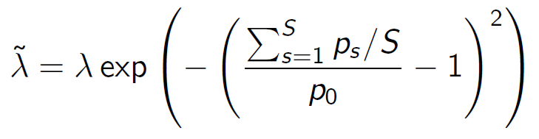
Applications of Evolutionary Game
Mobile User Churning Behavior
Stochastic Dynamic Evolutionary Game Formulation
  Connections are initiated at an average rate of λ
  Holding time is exponentially distributed with mean 1/µ
  Demand function, the effective connection arrival rate is
  S is total number of service providers
  p₀ is normal price
[<number>]

Slide 40
Applications of Evolutionary Game
Mobile User Churning Behavior
Stochastic dynamic evolutionary game can be modeled as a continuous-time Markov chain
State space of this Markov chain can be described as follows:
N_{s} is the number of users selecting service provider s
N is the total number of users in a service area
The transition rate can be derived given following events
  Connection arrival and departure
  Rational and irrational churning
[<number>]

Slide 41

Applications of Evolutionary Game
Mobile User Churning Behavior
Rational churning happens with rate from service provider s to s’
  User changes to service provider yielding higher payoff u(.)
Then, steady-state probability of Markov chain can be obtained which determines the probability of having n_{s} users for service provider s
[<number>]

Slide 42
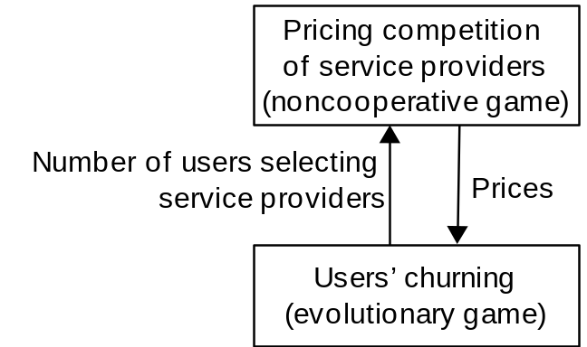


Applications of Evolutionary Game
Mobile User Churning Behavior
Given the model of churning behavior, the competitive pricing can be analyzed
Revenue earned by service provider s given price p_{s} is
is average number of users choosing service provider s (obtained from evolutionary game model)
[<number>]

Slide 43

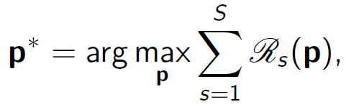
Applications of Evolutionary Game
Mobile User Churning Behavior
Solution of this price competition among the service providers is the Nash equilibrium, for which the condition is
Cooperative Pricing: all wireless service providers agree (i.e., collude) to choose the price so that their revenue is maximized
[<number>]

Slide 44
Summary
Basics of evolutionary games are presented and its advantages over the classical noncooperative game are discussed
  Equilibrium selection, bounded rationality, and dynamic behavior of players
Two approaches in the evolutionary game framework
  Static: evolutionary stable strategies (ESS)
  Dynamic: replicator dynamics with evolutionary equilibrium
Some of these applications have been discussed
  Congestion control
  Power control in CDMA,
  Cooperative sensing in cognitive radio
  Service provider selection (i.e., churning)
[<number>]

